Slide 1

OPTIMIZING ASTROGURU'S CALL CENTER PERFORMANCE
Data-Driven Strategies for Efficiency & Customer Satisfaction
Presented By – Aritra Khanra

Slide 2

INTRODUCTION
This project focuses on improving AstroGuru’s call center operations by enhancing efficiency and customer satisfaction. By analyzing consultation patterns, agent performance, and user feedback, we aim to identify key areas for improvement—whether through better training, smarter technology, or optimized workload distribution. The goal is to create a seamless experience for both users and astrologers, ensuring faster resolutions, higher satisfaction, and sustainable growth.
We can say in one line "This project aims to optimize AstroGuru’s call center by streamlining consultations, improving agent performance, and leveraging technology to boost customer satisfaction and operational efficiency."

Slide 3

PROJECT OBJECTIVES
Monitor Consultant Performance- To track and evaluate individual consultant effectiveness based on success rates, ratings, and revenue contribution.
Improve Customer Satisfaction- To identify factors affecting user experience and enhance service quality through better support and optimized consultation methods.
Optimize Operation Efficiency- To analyze peak hours, consultation type and failure patterns for better resource allocation and service planning.
Support Data Driven Decision- To provide actionable insights that guide strategic investments in hiring, training, and technology upgrades.

Slide 4

PROBLEM STATEMENT
Performance Analysis:
Analyze consultant performance based on revenue generation and success rates
Identify top-performing consultants who exceed the average revenue per consultation
Quality Improvement:
On a 10-point scale, anything below 5.0 is considered unsatisfactory.
Average Rating 2.93/10 falls into the “very poor" category, likely indicating widespread customer dissatisfaction.
Revenue Optimization:
Segment revenue by consultant type to identify most profitable services.
Calculate the 20% of consultants generating 80% of revenue.
Calls dominate revenue 70% share but have lower revenue per session
Low ratings correlate with high churn. Your 43.53% consult success rate could drop further
Operational Efficiency:
Correlate Total Gurus 149 and Total Visitors 28,027 with revenue to measure marketing efficiency
Analyze the consult success rate 43.53% to identify bottlenecks in the consultation process.
Data Visualization:
Create a dashboard that better presents the revenue distribution across consultants.
Develop visualizations to show trends in ratings, revenue, and consultation types over time

Slide 5

EXECUTION MAP
Data Gathering
Data Refinement
Initial Data Exploration
Dashboard Creation
Insight Extraction
Strategic Takeaways

Slide 6

FROM DATA TO DISCOVERY
Low overall consultation success rate.
Calls generate significantly higher revenue than chats.
Chat failure rate is higher than call failure rate.
Gurucool has more users than the app.
Morning shift sees the highest failure volume.
Peak call activity occurs during the morning shift.
Gurucool handles more consultations but also more failures.
Average user ratings are low across both platforms.
A few top gurus contribute a major share of total revenue.
Top 6 gurus are responsible for a major portion of the revenue.

Slide 7
KEY OBSERVATION
Gross Revenue (₹214,065.89) Total earnings generated from consultations.
Consult Success Rate (43.53%) Percentage of consultations deemed successful (criteria undefined).
Average Rating (2.93/5) Client satisfaction score, indicating moderate performance.
Total Visitors (28,027) Total volume of consultations or services delivered.
Total Gurus (149) Likely the number of active consultants or tools used.
Revenue by Consultant Type (Unspecified Distribution) Revenue segmented by service type (e.g., calls, chat), but data is incomplete.

Slide 8
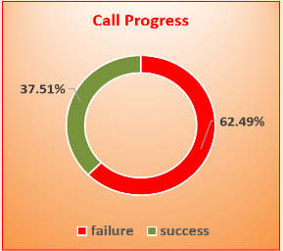
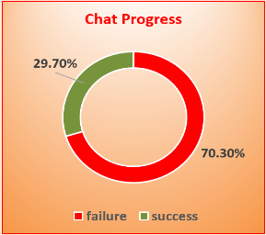
CALL AND CHAT PROGRESS
Call Progress:
Failure Rate: 62.49%
Success Rate: 37.51%
This indicates that more than half of all call consultations are failing, which is a serious concern.
Call performance is underperforming and needs urgent attention, possibly due to connection issues, dropped calls, or agent unavailability.
Chat Progress:
Failure Rate: 70.30%
Success Rate: 29.70%
Chat shows an even higher failure rate than calls, which is alarming.
Indicates major breakdown in chat workflows, possibly due to system crashes, slow responses, or unavailability of chat agents.

Slide 9
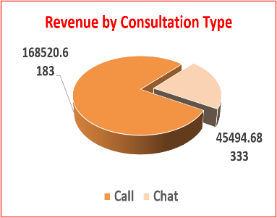
REVENUE BY CONSULTATION TYPE(CALL & CHAT)
The chart shows a comparison of revenue generated from two types of consultations: call and chat.
Call consultations contribute the majority of the overall revenue.
Chat consultations, while more frequent, generate significantly less revenue.
This indicates that call-based services are more profitable per consultation.

Slide 10
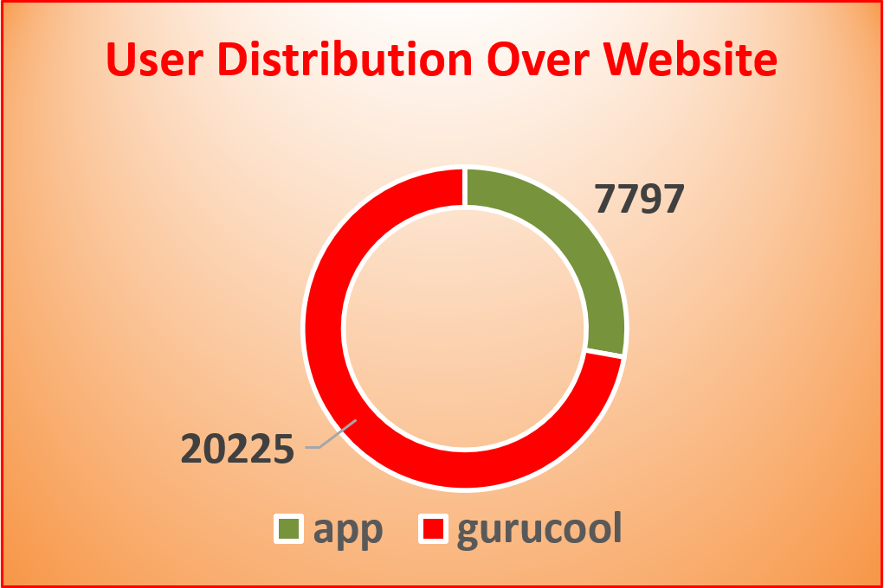
USER DISTRIBUTION OVER WEBSITE
The chart shows the comparison between users accessing through the app versus the Gurucool platform.
A larger portion of users prefer one platform significantly more than the other.
The distribution highlights a notable imbalance in user engagement across the two platforms.
This insight can help in deciding where to focus future development or marketing efforts.

Slide 11
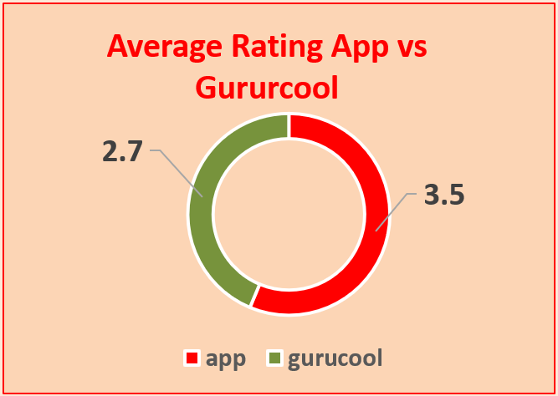
AVERAGE RATING APP VS GURUCOOL
The chart compares average user ratings between the app and the Gururcool platform.
Gururcool has a higher average rating than the app.
The visual highlights a noticeable difference in user satisfaction.
This suggests that users may be having a better experience on the Gururcool platform.

Slide 12
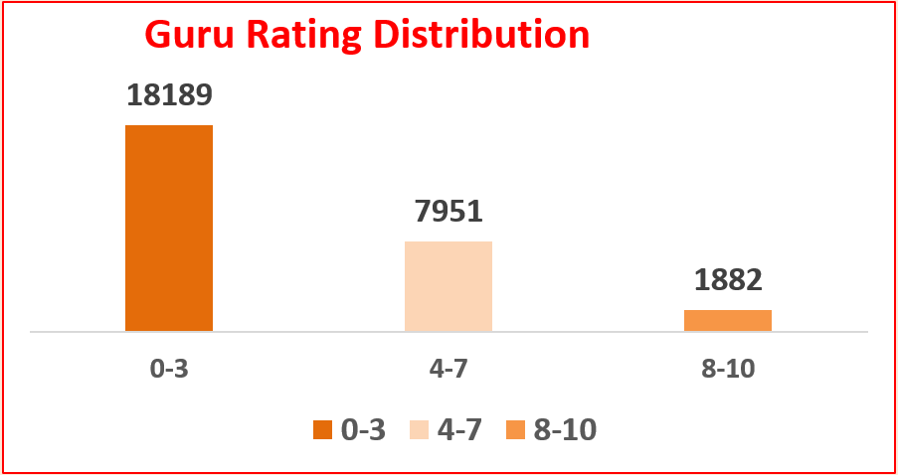
GURU RATING DISTRIBUTION
The chart displays the distribution of Guru ratings across three rating ranges: 0-3, 4-7, and 8-10.
It uses different colors to represent each rating range, with the 0-3 range having the tallest bar.
The 4-7 range shows a moderate distribution, while the 8-10 range has the shortest bar.
The chart indicates a significant concentration of ratings in the lower range compared to the higher ranges.

Slide 13
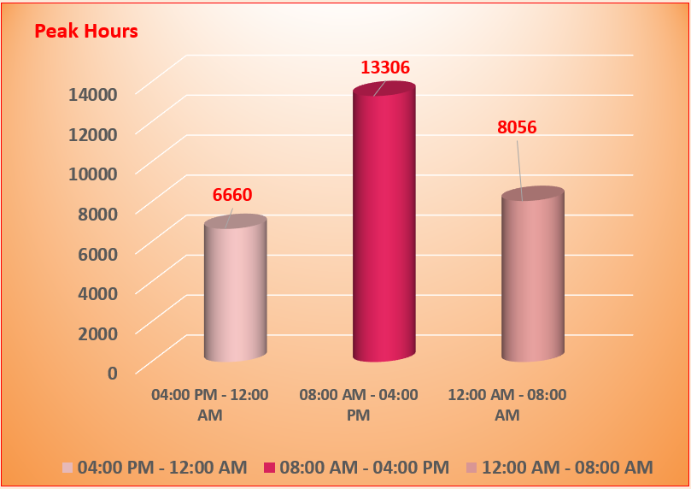
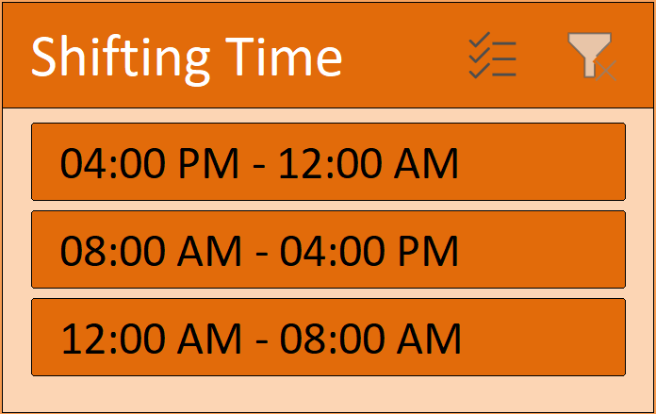
PEAK CONSULTATION HOUR
Morning shift (08:00 AM - 04:00 PM): This shift records the highest peak hours at 13306, indicating the busiest period of activity.
Evening shift (04:00 PM - 12:00 AM): This shift has the lowest peak hours at 6660, showing the least activity among the three shifts.
Night shift (12:00 AM - 08:00 AM): This shift records 8056 peak hours, placing it between the morning and evening shifts in terms of activity.
The data highlights a significant variation, with the morning shift experiencing the highest peak hours.

Slide 14
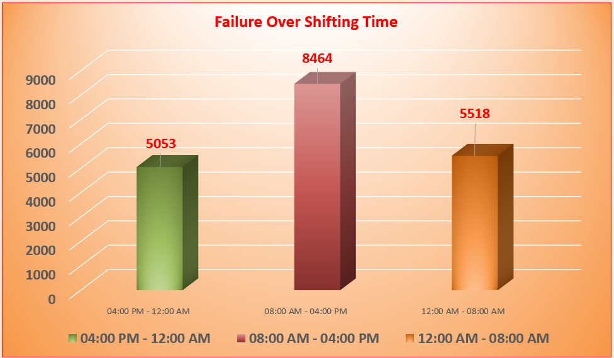
FAILURE COUNT OVER SHIFTING TIME
The highest failure count, 8464, occurs during the morning shift (08:00 AM - 04:00 PM).
The evening to midnight shift (04:00 PM - 12:00 AM) records 5053 failures, the lowest among the three shifts.
The night shift (12:00 AM - 08:00 AM) has 5518 failures, placing it between the other two shifts in terms of failure count.
The data indicates a significant variation in failure rates across the shifts, with the morning to afternoon shift experiencing the highest number of failures.

Slide 15
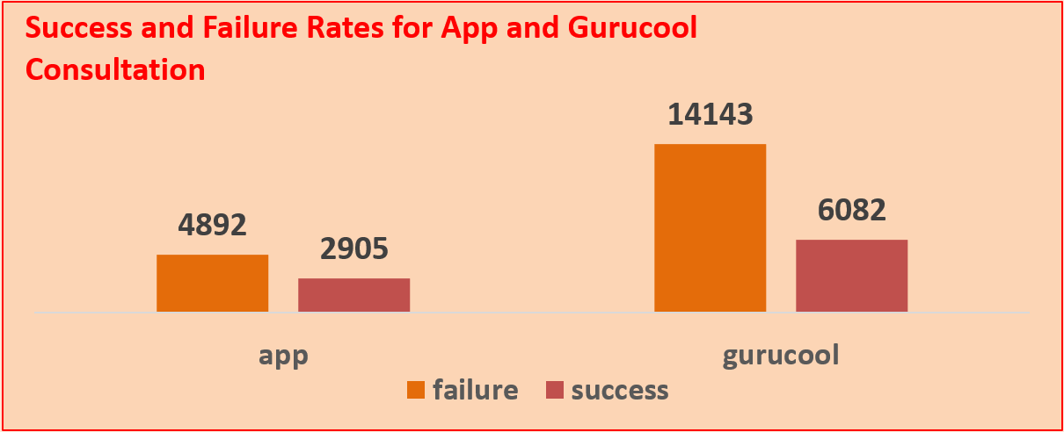
CONSULTATION SUCCESS & FAILURE–APP VS GURUCOOL
The chart compares success and failure rates for "app" and "gurucool" in consultation.
"App" shows a higher failure rate than success rate.
"Gurucool" has a significantly higher failure rate compared to its success rate.
The failure bar for "gurucool" is notably taller than its success bar.

Slide 16
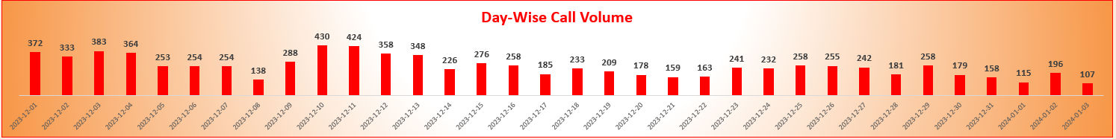
DATE-WISE CALL VOLUME
The chart shows the comparison between users accessing through the app versus the Gurucool platform.
A larger portion of users prefer one platform significantly more than the other.
The distribution highlights a notable imbalance in user engagement across the two platforms.
This insight can help in deciding where to focus future development or marketing efforts.

Slide 17
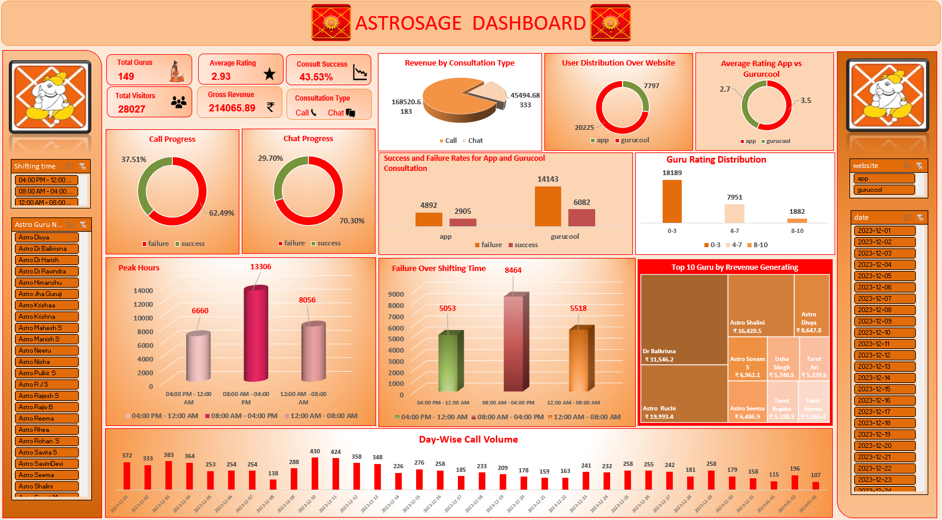

Slide 18

CONCLUSION
The dashboard indicates a high volume of user engagement, with a significant number of visitors and consultations, reflecting strong platform activity.
Revenue distribution shows a preference for chat-based consultations over calls, suggesting users may find chat interactions more convenient or accessible.
Peak activity occurs during specific time slots, highlighting the importance of scheduling resources to handle high demand periods effectively.
Chat success rates are notably higher than call success rates, indicating that chat-based services might be more reliable or preferred by users.
A considerable number of consultations fail, pointing to potential areas for improvement in service delivery or user experience to reduce failure rates.

Slide 19

RECOMMENDATION
Enhance Consultant Training
Provide regular skill development sessions to improve consultation quality and boost overall success rates.
Optimize Consultant Scheduling
Align consultant availability with peak user activity hours to ensure better engagement and reduced wait times.
Monitor Consultant Performance
Identify consistently underperforming consultants and provide support or intervention to improve user satisfaction.
Promote Top Performers
Highlight and reward consultants with high success rates and positive user feedback to encourage quality service.
Balance Staffing on Weekdays and Weekends
Ensure consultant availability matches user demand patterns throughout the week.
Focus on User Feedback
Actively collect and analyze user reviews to understand service gaps and improve overall experience.

Slide 20

THANK YOU
Aritra Khanra

